Slide 1

DARK WEB THREAT INTELLIGENCE
DarknetSearch
by Kaduu AG
Continuous dark, deep and open web monitoring that helps you find
leaks, exposed assets and impersonation before attackers use them.
CLIENT OVERVIEW · PRODUCT WALKTHROUGH
darknetsearch.com

Slide 2
AGENDA
What we'll cover
1
The Challenge
4
Alerts & Reporting
Why dark web exposure is a growing risk for every organization
Automated monitoring, incidents and executive reports
2
Platform Overview
5
Built For Your Team
One dashboard for continuous threat visibility
CISOs, threat intel analysts, SOC & MSSP use cases
3
Core Capabilities
6
Getting Started
Search, credential exposure, darknet chatter, attack surface, brand protection
Free trial, darknet report, and next steps
DarknetSearch by Kaduu
02

Slide 3
THE CHALLENGE
Your data is already being traded
somewhere you can't see
Stolen credentials, malware logs and lookalike domains circulate across dark web markets, Telegram channels, paste sites and criminal forums long before they show up in a breach headline.
24/7
2,200+
10+
24h
Continuous monitoring of
dark, deep and open web sources
Cybercrime Telegram &
forum channels tracked
Risk factors scored per
organization, automatically
Turnaround for a full
darknet exposure report
DarknetSearch by Kaduu
03

Slide 4
INTRODUCING DARKNETSEARCH
One platform for external
threat visibility.
DarknetSearch continuously scans the dark, deep and open web so you always know when your credentials, infrastructure or brand are exposed — and can act before attackers do.
01
02
03
Leak Detection
Attack Surface Discovery
Domain & Brand Protection
Identify stolen credentials, compromised devices and supply-chain exposure in real time.
See your network the way an attacker does — CVEs, open ports, and shadow IT.
Stop phishing and typo-squatting before lookalike domains go live.
DarknetSearch by Kaduu
04

Slide 5
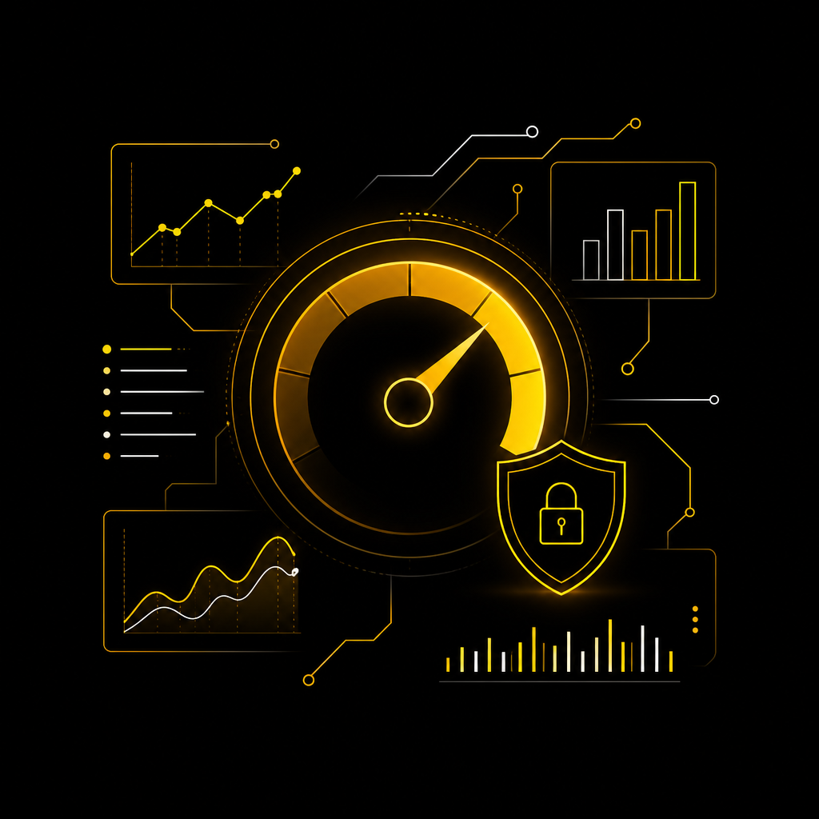
PLATFORM AT A GLANCE
Your risk score,
in one dashboard
Every organization gets a live Overall Risk Score, calculated from leak history, credential hygiene, exposed ports and search-engine exposure — with a 12-month timeline so you can track progress.
― Overall Risk Score — a single 0-100 number benchmarked against your industry and competitors.
― Top risk factors — recent vs. historical leaks, weak passwords, unusual open ports, search exposure.
― Risk timeline — trend your organization's risk and infrastructure risk over the past year.
― Credential & leaked-user stats — total leaked records, stealer logs, combo lists and riskiest users.
Risk scoring
Benchmarking
Trend timeline
Credential stats
DarknetSearch by Kaduu
05

Slide 6

CORE CAPABILITY · 01
Search the dark & deep
web in seconds
Quick Search sweeps every data source at once; Expert Search lets analysts build precise, boolean queries against a specific source — ideal for both first response and deep investigation.
― Search by anything — domain, email, name, IP, brand, password, file name or host name.
― 14 specialised sources — raw leaks, filtered & raw credentials, Telegram, Discord, pastes and more.
― Custom query builder — combine AND / OR / NOT operators, date ranges and file types for precision.
― Instant, deduplicated results — credentials, brokers, pastes and phishing hits ranked by relevance.
Raw Leaks
Telegram
Discord
Data Brokers
SSL Logs
DarknetSearch by Kaduu
06

Slide 7
CORE CAPABILITY · 02
Credential exposure,
scored and prioritized
Every leaked username / password pair tied to your domain is deduplicated and scored, so your team can focus on the accounts that matter most — not thousands of raw rows.
― Novelty, risk & reuse scores — instantly see which credentials are new, high-risk, or reused elsewhere.
― Own infrastructure vs. third party — separate internal logins from partner and client-side exposure.
― Stealer logs & combo lists — catch malware-harvested credentials, not just old breach dumps.
― Comparison reports — benchmark credential exposure across subsidiaries, brands or peers.
Unique credentials
Password reuse
Stealer logs
Combo lists
Domain accounts
DarknetSearch by Kaduu
07

Slide 8
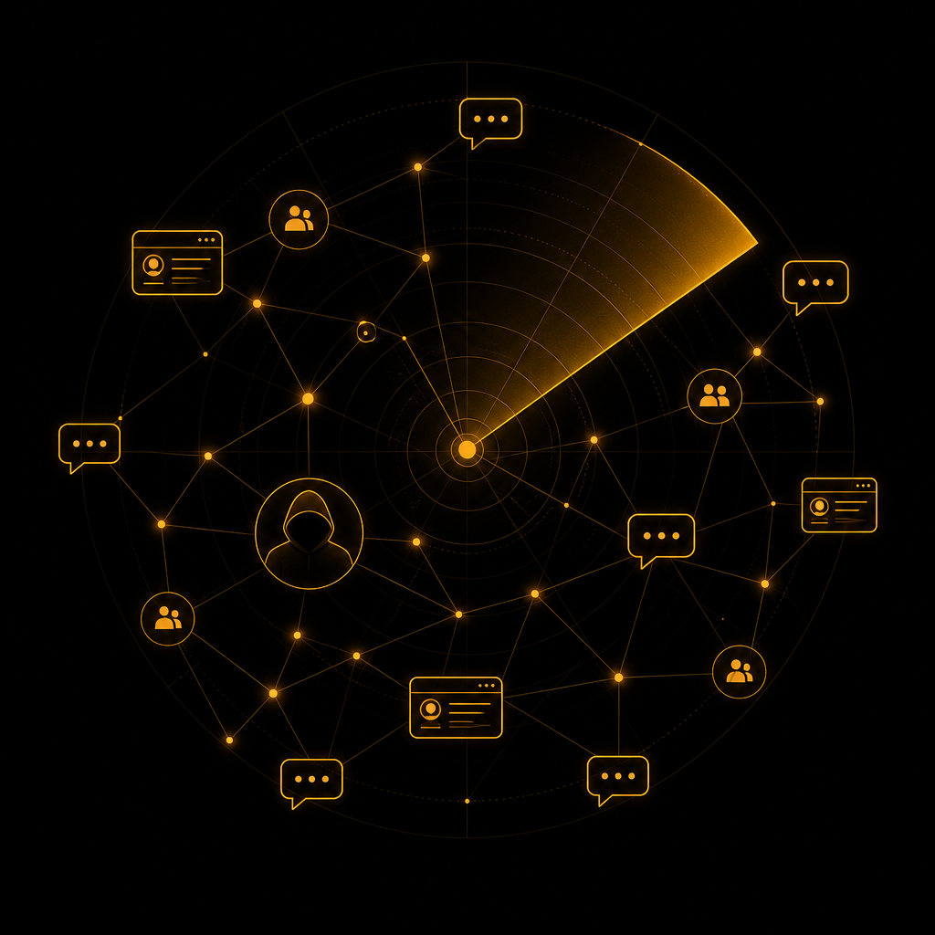
CORE CAPABILITY · 03
Real-time darknet
chatter monitoring
Track cybercrime forum posts, marketplace listings and threat-actor activity the moment they appear — across thousands of Telegram channels, forums and carding sites.
― 2,200+ monitored channels — Telegram, Discord and dark forums searched with boolean operators.
― Threat actor tracking — attribute chatter to known aliases and monitor ransomware groups directly.
― Categorised results — marketplaces, leaks & data, carding/fraud, hacking, services, discussion.
― Live investigations — query Tor / I2P and closed channels discreetly through our proxy network.
Marketplaces
Leaks & Data
Carding / Fraud
Threat Actors
Live Search
DarknetSearch by Kaduu
08

Slide 9
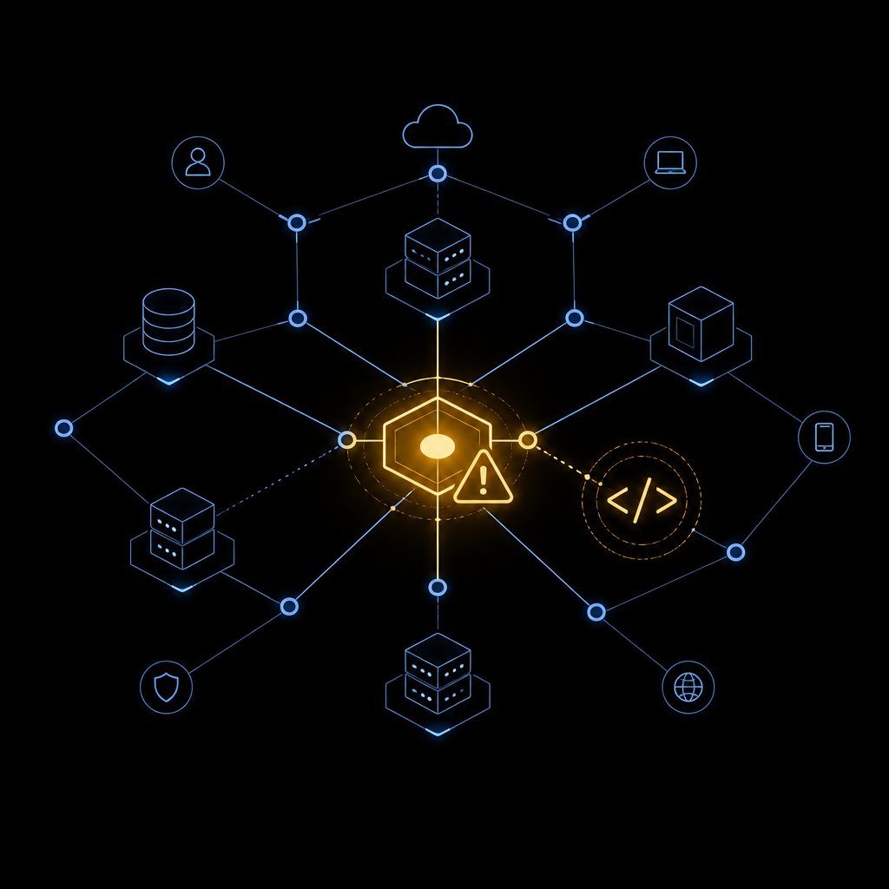
CORE CAPABILITY · 04
Attack surface &
code exposure scanning
See your organization the way an attacker does. Discover forgotten assets, risky configurations, and secrets leaked in public code before someone else finds them.
― Attack Surface Discovery — automatic visibility into internet-facing hosts, CVEs and open ports.
― Shadow IT detection — surface assets added by developers, agencies or freelancers you didn't know about.
― Code Exposure scanning — keyword scans across GitHub, Gist, GitLab, Postman and Google dorking.
― Contributor-based scoping — map an org's public repos and contributors to focus scans precisely.
CVEs
Open Ports
GitHub
Gist
Postman
DarknetSearch by Kaduu
09

Slide 10

CORE CAPABILITY · 05
Domain & brand
protection
Stop threat actors from spoofing your brand before a phishing site goes live — across lookalike domains, app stores and social platforms.
― Typo-squatting detection — daily monitoring of new domain registrations and SSL transparency logs.
― Visual logo-spoofing analysis — WHOIS, geolocation, screenshots and web risk score for every domain found.
― App store & social monitoring — spoofed apps on iTunes / Google Play and fake brand profiles.
― Dedicated risk reports — Domain Spoofing, VIP Executive, Social Media and Application Security reports.
Typo-squatting
SSL Transparency
App Stores
VIP Executive Report
DarknetSearch by Kaduu
10

Slide 11

CORE CAPABILITY · 06
Automated alerts &
incident response
Turn continuous monitoring into action. Create rules once, and get notified the moment something matters — with full context to investigate immediately.
― Custom alert rules — build queries against any data source and choose your notification frequency.
― Incident feed — every trigger logged with status, source and one-click drill-down into raw data.
― Extracted entities — domains, usernames and passwords auto-extracted from every match.
― Smart exclusions — silence false positives and recurring matches with reusable exclusion rules.
Alert Rules
Incidents
Exclusions
Webhooks
DarknetSearch by Kaduu
11

Slide 12
CORE CAPABILITY · 07
Executive reporting &
industry benchmarking
Translate raw threat data into board-ready reports — scheduled automatically or generated on demand, and benchmarked against your industry and competitors.
― Full assessments — one-click reports covering breach risk, infrastructure, spoofing and app security.
― Leaked Credential Comparison Report — benchmark exposure across divisions, subsidiaries or peers.
― Scheduled delivery — recurring reports land in your inbox automatically, no manual work required.
― Darknet Exposure Report — a one-time, 24-hour deep dive delivered as PDF + raw CSV data.
Breach Risk
Infrastructure Risk
Domain Spoofing
VIP Executive
Scheduled Reports
DarknetSearch by Kaduu
12

Slide 13
BUILT FOR YOUR TEAM
Targeted insights for every role
in cybersecurity
CISOs
Threat Intelligence Analysts
SOC Analysts
Strategic visibility & risk prioritization
Detect, correlate, contextualize
Faster, more accurate response
Continuous visibility into leaked credentials, exposed access and third-party breaches — translated into clear, board-ready insights for governance and compliance.
Unify dark web search, stolen-data monitoring, stealer-log analysis and threat-actor profiling in a single workflow to validate emerging threats earlier.
Enrich SIEM and incident investigations with external dark web signals to confirm incidents faster, cut false positives, and reduce mean time to respond.
DarknetSearch by Kaduu
13

Slide 14
ENTERPRISE & MSSP READY
Built to scale across teams,
brands and clients
MANAGE ORGANIZATIONS
Manage every subsidiary, brand or client from a single account — with granular roles, usage visibility and full API access for automation.
Your Organization
ACTIVE
Default
― Multi-tenant organization management — switch between client accounts instantly
― Role-based access control with 2FA — System Admins, Org Users and more
― Usage dashboards — track quota by service (searches, alerts, reports, API calls)
― Full REST API — push alerts and leak data directly into your SIEM or SOAR
Client / Subsidiary A
Insurance
Client / Subsidiary B
Telecom
Client / Subsidiary C
Banking
Client / Subsidiary D
Financial Services
DarknetSearch by Kaduu
14

Slide 15
WHY CLIENTS TRUST US
Trusted by security teams
across industries
“
“
“
Uses DarknetSearch to detect client data leaks, exposed assets and domain spoofing in real time. Alerts and API reporting help their SOC respond faster.
Detects leaked credentials and breaches across the dark web, feeding alerts straight into their SIEM to proactively rotate credentials at enterprise scale.
Monitors the dark web for leaks and exposed data affecting the NGOs they support — valued for ease of use and relevance of intelligence despite limited resources.
Cloud y Olé
Bühler
CyberPeace Institute
Managed Security Provider
Global Industrial Manufacturer
Swiss Cybersecurity NGO
Rated on G2 · g2.com/products/kaduu/reviews
DarknetSearch by Kaduu
15

Slide 16
GETTING STARTED
See your exposure.
Start today.
7-Day Free Trial
Darknet Exposure Report
Tailored Quote
Explore the full DarknetSearch platform — no commitment, no credit card.
One-time deep dive: exposed credentials, leak trends, risky users and spoofed domains. Delivered as PDF + CSV within 24 hours.
Get enterprise or MSSP pricing scoped to your organization's size and risk profile.
START FREE TRIAL
REQUEST YOUR REPORT
REQUEST A QUOTE
DarknetSearch by Kaduu
16

Slide 17
Let's find what's already exposed.
Thank you — we look forward to showing your organization's live risk score.
darknetsearch.com
Kaduu AG · Switzerland

